Slide 1
Mini Project 2

Slide 2
Summary
Topics discussed:
Deep learning for Siri’s voice
Speech synthesis
Unsupervised learning
Principal component
Cluster analysis
Association rule
Mixture models
Anomaly detection
Dimension reduction
Supervised learning
KNN

Slide 3
Unsupervised ML
cluster analysis
k-means clustering
Gaussian Mixture Model
SOM
GAN
Boolean association rules
association rule
single-dimensional association rules
ANN
multi-dimensional association rules
Artificial Neural Network
ANN
ART

Slide 4
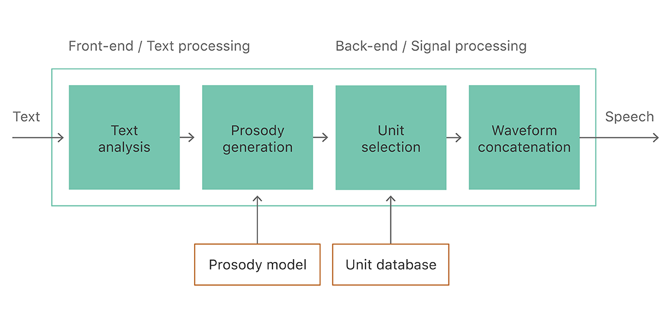
Deep learning for Siri’s voice Dingjun Bian
Apple has their own apple deep learning journal
Text to Speech synthesis process:
Neural network model: deep mixture density network
a feed forward neural network model
combine convolution neural network model and Guassian mixture models
can model complex and nonlinear relationship between input and output
can deal with transitions between voiced and unvoiced speech properly

Slide 5
Defect Detection
Analysis of machine learning methods that can be used to detect defects within steal products.
Algorithms considered:
Artificial neural networks – accurate, layers of interconnected inputs and outputs to learn how to classify it properly.
Support vector machine – good at binary classification problems, cons: training time is long.
K-nearest neighbors
Recommendations:
Self organizing map - a type of unsupervised classifier implemented as a neural network, very effective in identifying new data provided.

Slide 6
Unsupervised Learning
Main applications of unsupervised learning:
Cluster Analysis
Association Rule
Dimension Reduction
Method:
K-means Clustering: A method originated from signal processing is more popular in the field of data mining as a clustering analysis method.
Mixture Model: It is a probability model used to represent the existence of the population.
Anomaly Detection: Identification of items, events, or observations that do not conform to the expected pattern or other items in the data set.
Notes:
Unsupervised learning is a method of machine learning, which can automatically classify or group the input data without giving the training examples.
A method originated from signal processing is more popular in the field of data mining as a clustering analysis method. The purpose of K-means clustering is to divide n points into K clusters, so that each point belongs to the cluster corresponding to its nearest mean, and take it as the standard of clustering.
It is a probability model used to represent the existence of the population.
Compared with supervised learning:
Training data for unsupervised machine learning is not labeled. The system will try to learn by itself. For example, if you have a website, you have a lot of data about your website visitors. You can use clustering algorithm to try to group similar visitors, and the algorithm will find the association between visitors. For example, it may find that 40% of the visitors are male. They like comics and usually read your articles at night. 20% of them are young science fiction fans and often visit your website on weekends.

Slide 7
Compared with supervised learning:
Supervised machine learning: eg. spam filter
Unsupervised machine learning: The system will try to learn by itself.
Pro:
Reduce dimension:Unsupervised learning need to extract features, or use layer/item clustering to reduce the dimension of data features.
It is often easier to get unlabeled data — from a computer than labeled data, which need person intervention. This is also a key difference between supervised and unsupervised learning.

